Slide 1
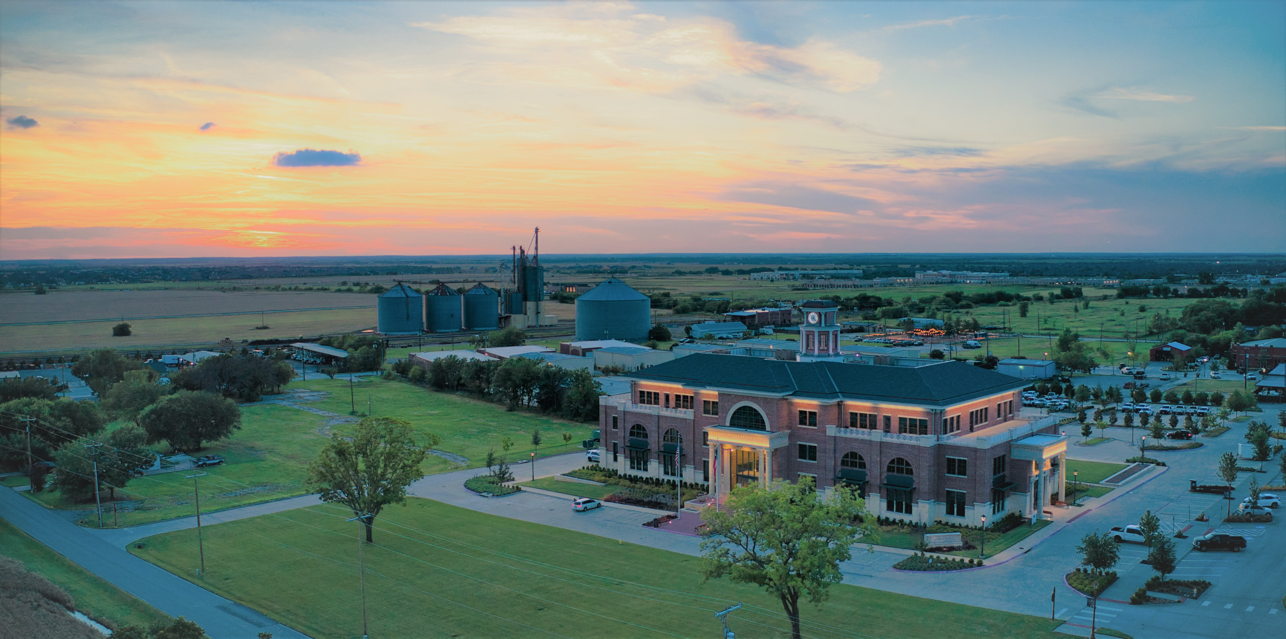
Budget Town Hall

Slide 2










Town Council Strategic Visioning Priorities
ACCELERATION OF INFRASTRUCTURE
Work with the Capital improvement Subcommittee to identify gaps in the Town’s infrastructure and ensure that it meets the demands of a growing community
Utilize all available financial methods (Bonds, Certificates of Obligation, Capital Dedicated Fund, Grants, etc.) to fund projects.
Work with the Capital Improvement Subcommittee to plan for a future bond program and/or pay-as-you-go program.
DEVELOPMENT OF DOWNTOWN PROSPER AS A DESTINATION
Collaborate with the Downtown Business Alliance, Community Engagement Committee, Downtown Committee, and Prosper EDC to implement the Downtown Master Plan.
Pursue a mix of public and private developments as catalysts for office, retail, restaurants, entertainment, housing, and outdoor events.
ENSURE THE TOWN’S COMMERCIAL CORRIDORS ARE READY FOR DEVELOPMENT
Ensure US 380 and Dallas North Tollway are primed and ready for development.
Develop long-term strategies for land use, landscaping, lighting, and traffic.
Leverage partnerships with TxDOT, NTTA and private development.
CONTINUE TO PROVIDE EXCELLENT MUNICIPAL SERVICES
Strive to be a high-performing organization focused on continuous improvement, best practices, and benchmarking.
Develop a culture of excellence and provide the financial resources necessary to support these goals.
Provide a welcoming and respectful environment for residents, visitors, and Town employees.
WORK TOWARDS A GROWING AND DIVERSIFIED TAX BASE
Collaborate with Prosper EDC and be adaptable to changing market conditions.
Place an emphasis on corporate, medical, and life-sciences sectors.
Utilize metrics to create resiliency strategies against market changes.

Slide 3
Budget Timeline
February 27, 2024 Multi-Year Budget Projections
May 28, 2024 Adopted Strategic Vision Priorities
Spring/Summer 2024 Sub-Committee Meetings on Capital Project Prioritization, Debt Issuance, Market Adjustments
July 25, 2024 Certified Rolls
July 30, 2024 Budget Workshop at Council Work Session
August 13, 2024 Presentation of Preliminary Budget, Passage of all items needed to begin Budget Adoption Process.

Slide 4
Budget Timeline
Before August 23, 2024 Sub-Committee Meetings per Council Direction
August 29, 2024 Budget Town Hall Meeting
September 10, 2024 Budget Public Hearing, Final Changes (if any) and Adoption; Tax Rate Public Hearing and Adoption; Tax Increase Ratification

Slide 5
Budget in Brief
Total FY 2024-2025 Preliminary Budget Operating Appropriations $102,622,254 including:
$52,819,628 for General Fund operations and maintenance,
$3,346,035 for the Crime Control and Prevention Special Purpose District,
$3,544,260 for the Fire Control, and Emergency Medical Services Special Purpose District,
$42,912,331 for the Town’s Enterprise Funds including Solid Waste, Water, and Sewer utilities as well as the Storm Drainage Utility Fund.
General Debt Service Appropriations for the coming fiscal year are $18,526,992.
Governmental Capital Projects added for the year total $51.4 million.

Slide 6
Key General Fund Revenue Drivers
For FY 2024-2025, General Fund revenues are expected to total $51,207,806 which is an increase of 7.04% over the previous year’s amended budget. This additional revenue is from increased property tax, sales tax, and franchise fees.
The Preliminary Budget reflects 10.6% growth from FY 2023-2024 year-end projected sales tax receipts. This is the seventh year for the Special Purpose Districts that receive sales tax that had been previously reported in the General Fund. The General Fund is projecting sales tax revenue of $12,659,839 for FY 2024-2025.

Slide 7
General Fund Staffing
Department | Title | Start Date | FTE | Recurring | One-time | Grant Revenue | Year 2
Town Managers Office | Management Analyst | 10/1/2024 | 1 | 105,000 | 10,000 | - | 105,000
Finance | Fleet Coordinator | 1/1/2025 | 1 | 72,003 | 48,730 | - | 95,499
Communications | Communication Specialist increase to Full-time | 10/1/2024 | 0.5 | 34,091 | - | - | 34,091
Municipal Court | Municipal Court Clerk | 1/1/2025 | 1 | 47,399 | - | - | 47,399
Police | Administrative Assistant-Patrol | 4/1/2025 | 1 | 13,171 | 36,515 | - | 69,419
Police | Detective | 4/1/2025 | 1 | 80,049 | 115,264 | - | 150,101
Police | Police Officers (COPS Grant) | 1/1/2025 | 5 | 579,298 | 505,917 | 333,333 | 749,943
Police | 9-1-1 Communications CAD Supervisor | 4/1/2025 | 1 | 65,425 | 5,369 | - | 127,553
Fire | Fire Inspector/Investigator | 1/1/2025 | 1 | 100,072 | 102,265 | - | 128,444
Public Works | Signs and Marking Technician | 4/1/2025 | 1 | 40,716 | - | - | 77,323
Public Works | Streets Utility Worker | 1/1/2025 | 1 | 58,420 | - | - | 76,724
Public Works | Facilities Maintenance Technician | 1/1/2025 | 1 | 51,700 | - | - | 61,692
Parks | Irrigation Technician | 4/1/2025 | 1 | 37,558 | 51,456 | - | 72,977
Parks | Parks Supervisor | 11/1/2024 | 1 | 92,738 | 52,529 | - | 100,971
Library | Library Assistant PT to FT | 10/1/2024 | 0.5 | 30,286 | - | - | 30,286
Engineering | Senior Traffic Engineer | 1/1/2025 | 1 | 101,028 | 20,686 | - | 141,929
 | Total General Fund |  | 19 | 1,508,954 | 904,631 | 333,333 | 2,069,351

Slide 8
Other Funds Staffing
Water/Wastewater Fund
Department | Title | Start Date | FTE | Recurring | One-time | Grant Revenue | Year 2
Public Works | Crew Leader | 10/1/2024 | 1 | 98,141 | 99,820 | - | 98,141
Public Works | Heavy Equipment Operator | 10/1/2024 | 1 | 85,270 | 335 | - | 85,270
Public Works | Utility Worker | 10/1/2024 | 1 | 75,672 | 1,800 | - | 77,472
 | Total Water/Wastewater Fund |  | 3 | 259,083 | 101,955 | - | 260,883
Stormwater Drainage Fund
Department | Title | Start Date | FTE | Recurring | One-time | Grant Revenue | Year 2
Public Works | Stormwater Crew Leader | 10/1/2024 | 1 | 168,280 | 14,502 | - | 103,830
 | Total Stormwater Drainage Fund |  | 1 | 168,280 | 14,502 | - | 103,830

Slide 9
Market Study
Fund | Recurring
General Fund - Police-Sworn | 232,513
General Fund - Fire-Sworn | 228,464
General Fund | 311,881
Water/Wastewater | 37,601
Total Market Study | 810,459
Public Safety Market Methodology
The average minimum and maximum annual rates of pay at benchmark cities. The data is anchored at the minimum and maximum annual rates for each respective rank and file.
Competitive percentage above market average – 1.75%
Non-Public Safety Market Methodology
(Max Average + Min Average)/2 = Midpoint

Slide 10
Major General Fund Enhancements
Administration:
Comprehensive Compensation and Benefits Study-$65,000
IT Security and Other Enhancements-$274,419
Police:
Stratified Policing Accountability Model - $276,049
Flock Safety Program Expansion (Grant) - $367,250
Officer Safety Equipment (Grant) - $79,163
Fire:
Radio Replacement (year 1 of 4) - $91,628
Online Paramedics School - $41,250
Streets
Street Markings and Sign Repairs - $73,102
Building Repairs - $50,000
Parks and Recreation:
Increased Community Events - $90,050
New Parks and Median Maintenance - $362,000

Slide 11
Other Funds
Utility Fund-Distribution and Collection Utility
Potable Water Supplier proposing over 13.8% increase in rates
Wastewater treatment supplier requires significant capital investment for new treatment plant
Rate Consultant projecting need for multiple year rate increases including a blended 8.77% next year (6.3% water and 16% wastewater)
First Rate Increase in four years (2020)
Solid Waste Fund
Created in 2023, the fund is self-supporting through rates.
Stormwater Drainage
No rate increase recommended. Last rate increase 2018.

Slide 12
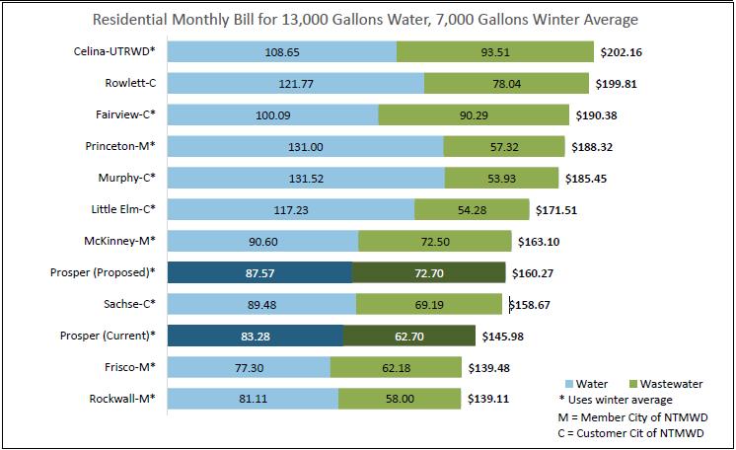
Rate Comparison

Slide 13
Debt Service Fund
Add Series 2024 authorized by Council - $36.407 Million
Redeem Series 2014 - $600,000 ($140,000 savings)
$152 million available for 2025 Bond Election
Increases I&S Rate from 0.177258 to 0.180392
36% I&S percentage of total Tax Rate (below 40%)
Outstanding Total Debt of $228,582,000 at end of FY24-25
2.4% Outstanding Total Debt as a percentage of TAV (below 4%)
$5,366 Outstanding Total Debt per Capita

Slide 14
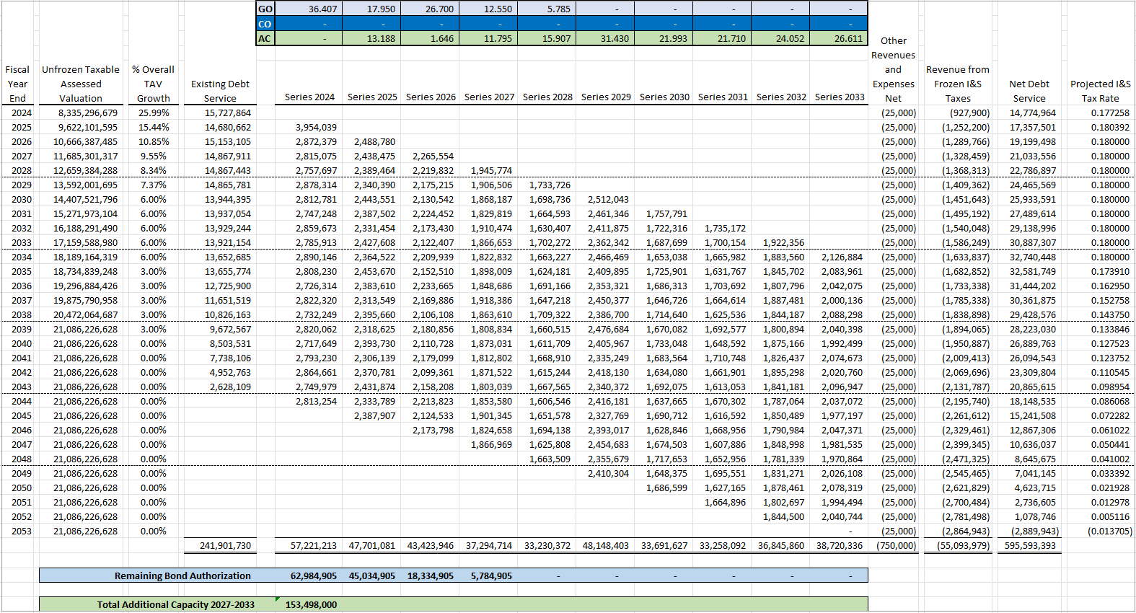
Debt Service Fund

Slide 15
Governmental Capital Projects
$35.9 million in Streets Projects
$6.6 million in Parks Projects
$5.3 million in Facility Projects
$2 million in Public Safety Projects
$1.5 million in Unrestricted Projects
$51.3 million Total in Projects

Slide 16
Multi-Year Capital Program/Debt Issuance
Recently Approved Bonds 2023-2024
Parks and Recreation Projects ($4,270,000 Authorization Remaining of $30,000,000)
Raymond Community Park, Phase 1: (Construction) $10,900,000
Public Safety Projects ($1,200,000 Authorization Remaining of $30,000,000)
Fire Station #4 (Construction) $10,200,000
Street and Transportation Projects ($57,514,905 Authorization Remaining of $150,000,000)
First Street (DNT – Coleman): (Construction) $9,000,000
Coit Road (First – Frontier) – 4 lands: (Land/Esmt) $1,700,000
Teel (US 380 – First St.) 2 NB Lanes (Construction) $1,400,000
Legacy (First – Star Trail) 2NB Lanes (Construction) $650,000
Braided Ramps $2,557,062
TOTAL $36,407,062

Slide 17
Multi-Year Capital Program/Capital Dedicated
Pay-as-you-go Funding
Parks
Parks and Public Works Facility, Phase 1 $2,352,938
Public Safety
Fire Station #4 (Construction) $2,500,000
Street
Traffic Signal – First & Artesia $230,000
Traffic Signal – Teel & Prairie $460,000
Braided Ramps $2,557,062
Unprogrammed $1,500,000
TOTAL $9,600,000

Slide 18
Historical Property Valuation
Fiscal Year | Valuation Excluding Freeze | Growth | New Property | Growth from New Property | Reappraisal Growth | Growth from Reappraisal
2019-2020 | 4,209,067,499 | 12.4% | 414,634,110 | 11.1% | 49,749,601 | 1.3%
2020-2021 | 4,601,196,301 | 9.3% | 360,557,369 | 8.5% | 31,571,433 | 0.8%
2021-2022 | 5,437,210,564 | 18.2% | 469,526,490 | 10.2% | 366,487,773 | 8.0%
2022-2023 | 6,616,007,870 | 21.7% | 596,431,779 | 11.0% | 582,365,527 | 10.7%
2023-2024 | 8,335,296,679 | 26.0% | 876,474,004 | 13.3% | 842,814,805 | 12.7%
2024-2025 | 9,622,101,595 | 15.4% | 878,599,323 | 10.5% | 408,205,593 | 4.9%

Slide 19
No-New-Revenue Tax Rate
The “No-New-Revenue" rate is the highest property tax rate a local government can adopt that generates the same amount of revenue as the previous year, despite changes in property values.
The calculation excludes impact from new property and property in a TIRZ.
Compares like property year over year.

Slide 20
Voter-Approval Tax Rate
The “voter approval” rate is the maximum property tax rate increase, 3.5% on M&O plus calculated I&S Rate, that local taxing units can implement without voter approval.
Mandated to adopt the calculated I&S rate.

Slide 21
Property Tax Rate Comparison
 | 2024-2025 | 2023-2024
No-New-Revenue Tax Rate | $0.466941 | $0.448160
Voter-Approval Tax Rate | $0.522075 | $0.51
Debt Rate (I&S Rate) | $0.180392 | $0.177258
Adopted Rate | - | $0.51
Proposed Rate | $0.505 | -

Slide 22
Historical Property Tax Rate
Fiscal Year | M&O | I&S | Total Rate
2019-2020 | 0.367500 | 0.152500 | 0.520000
2020-2021 | 0.367500 | 0.152500 | 0.520000
2021-2022 | 0.328000 | 0.182000 | 0.510000
2022-2023 | 0.329830 | 0.180170 | 0.510000
2023-2024 | 0.332742 | 0.177258 | 0.510000
2024-2025 | 0.324608 | 0.180392 | 0.505000

Slide 23
Benchmarking Proposed Fiscal Year 2024-2025 Tax Rates
Entity | Homestead Exemption Rate | General Fund | Capital Dedicated | I&S | Total Tax Rate | Equivalent Tax Rate for Homestead | Freeze
Anna | 5.0% | 0.360213 | - | 0.146987 | 0.507200 | 0.481840 | No
Celina | None | 0.287061 | - | 0.311107 | 0.598168 | 0.598168 | Yes
Coppell | 5.0% | 0.392071 | - | 0.070151 | 0.462222 | 0.439111 | No
Flower Mound | 12.5% | 0.348344 | - | 0.038956 | 0.387300 | 0.338888 | No
Frisco | 15.0% | 0.283406 | - | 0.142111 | 0.425517 | 0.361689 | Yes
Keller | 20.0% | 0.249292 | - | 0.043888 | 0.293180 | 0.234544 | Yes
Little Elm | None | 0.435787 | - | 0.124113 | 0.559900 | 0.559900 | Yes
McKinney | None | 0.278935 | - | 0.136578 | 0.415513 | 0.415513 | No
Southlake | 20% | 0.250000 | - | 0.055000 | 0.305000 | 0.244000 | Yes
Average of Comparison | 8.61% | 0.320568 | - | 0.118766 | 0.439333 | 0.408184 | -
Prosper (FY2023-2024) | 15.0% | 0.230742 | 0.102 | 0.177258 | 0.51 | 0.4335 | Yes
Prosper (FY2024-2025) | 17.5% | 0.224608 | 0.10 | 0.180392 | 0.505 | 0.416625 | Yes

Slide 24
Total Tax Rate

